Slide 1

Classifications related to IMTS
IMTS 2026 – Chapter V
(HS and analytical classifications, say SITC and BEC)
by
Vysaul Nyirongo (email: nyirongov@un.org)

Slide 2
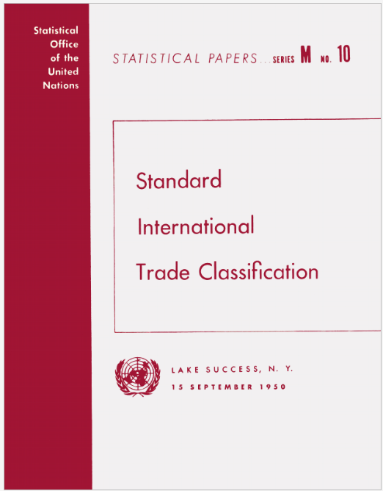

IMTS related classifications
Harmonized System (HS) Central Product Classification (CPC) SITC – Standard International Trade Classification BEC – Classification by Broad Economic Categories ISIC – International Standard Industrial Classification of All Economic Activities
Some history of classifications in trade The SITC is the earliest internationally agreed commodity classification (since 1950) However, in 1993, the UNSC endorsed the use of the HS for collection and dissemination of IMTS In 1999, the UNSC confirmed SITC as an analytical tool

Slide 3
Relationship between different classifications

Slide 4


Importance of classifications
A detailed commodity classification is required to identify and categorize commodities and present them in an internationally consistent way for customs, statistical and analytical purposes, and trade negotiations Complex nature of customs, statistical and analytical needs. example needs include granular data, ability for thematic/sector aggregation

Slide 5
Summary of key chapter changes (IMTS 2026 –Chapter V)
Streamlining of some historical information and content specific to the current versions of the classification Each classification has its own publication which can be referred to by readers. For IMTS compilation, countries are recommended to use the most current edition of HS; and to avoid mixing different editions of HS in a specific period.

Slide 6
Summary of key chapter changes (IMTS 2026 –Chapter V)
For some analytical purposes, the HS is not always the most appropriate. Recognize different classifications for different purposes The Standard International Trade Classification (SITC) The Central Product Classification (CPC) The Classification by Broad Economic Categories (BEC) The BPM7 standard components of the Goods account (three broad categories: general merchandise, goods under merchanting and non-monetary gold) Also, various sub-groupings of HS or SITC categories are established by agencies, supranational or regional organizations.
Notes:
Customized commodity groupings. customized commodity groupings may be developed, such as for ICT goods, creative goods, high-tech goods etc.

Slide 7
Standard International Trade Classification (SITC)
The last revision (SITC rev.4) was in 2006, aligning with HS 2007 Basic headings (except for 911.0; 931.0: postal packages and special transactions; commodities not classified according to kind) defined in terms of HS subheadings. An aggregation of HS categories considering: The nature of the merchandise and the materials used in its production. The processing stage. Market practices and the uses of the product. The importance of the commodity in terms of world trade. Technological changes.

Slide 8
Standard International Trade Classification (SITC)
Issues
Deteriorating correspondence with newer version of HS
  Amendments in HS 2022, notably on electronic components
  Increasing number of 1:N and N:N relationships
Revision cycles, if required
Relationships between HS editions and SITC 4
 | SITC 4
 | 1To1 | NTo1 | 1ToN | NToN
HS 2002 | 1867 | 3157 | 65 | 381
HS 2007 | 1996 | 3056 | 0 | 0
HS 2012 | 1923 | 3230 | 18 | 127
HS 2017 | 1779 | 3496 | 24 | 704
HS 2022 | 1257 | 4156 | 23 | *7755
* Involving 194 HS subheadings with 894 SITC 5-digit codes

Slide 9
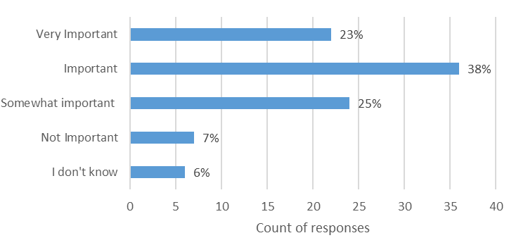
Standard International Trade Classification (SITC)
Indications were that many users still find the classification useful for analytical purposes Decennial survey (2016-2017): 82 out of 108 respondents publish data in SITC. The global consultation on research topics in Dec 2021: re-affirmed the need for SITC revision
Importance of the revision of SITC Rev. 4 (decennial survey)

Slide 10
The cost-benefit of revising SITC
A concern by UNCEISC in 2024 about the need for SITC revision Users have gradually moved to using HS even for analytical needs? Compilers continue producing SITC for historical reasons rather than users’ needs? Compare and contrast with other classifications e.g. the Central product Classification, BEC and sectoral product classifications/lists. TT-ITS to reflect further and research the cost-benefit of revising SITC Concept note and focus group discussions Comtrade user survey, 2025

Slide 11
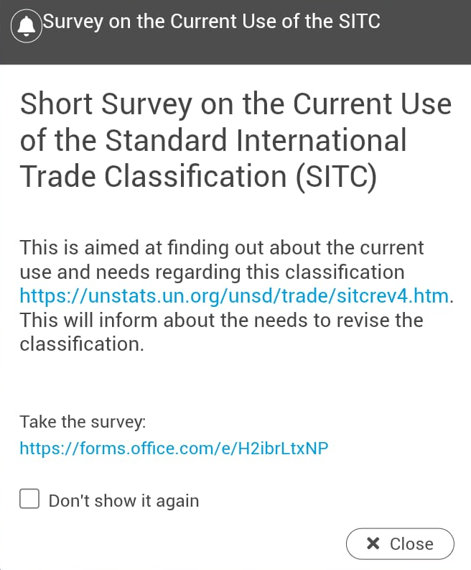

Can we do a small survey here?
https://forms.office.com/e/22mSbJmKQi?origin=lprLink
[results]

Slide 12
Proposed option regarding revising SITC
Option A: The SITC is discontinued and is no longer maintained. HS has and other classifications, to some extent, replaced SITC for analytical needs and that the cost to maintain SITC is greater than the benefit. Option B: The SITC is revised but maintained up to a 3-digit level. The 3-digit level is sufficient to describe the top traded commodities in the world while keeping the data granular enough for deeper analysis. Option C: The SITC is revised according to historical practices. Create or delete SITC codes at any level according to analytical needs.

Slide 13
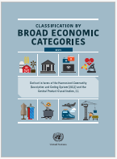
Classification by Broad Economic Categories (BEC)
An international product (goods and services) classification Provide a set of broad product categories that can be utilized for the analysis of trade statistics – linked to end-use of products in SNA Intermediate, Capital and Final Consumption Statistics for flow analysis of imported goods and services; and patterns: inform about tariff effects, trade or economic policy

Slide 14
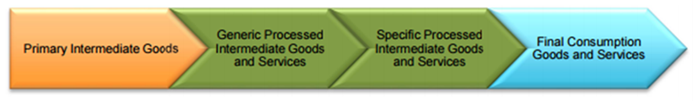
BEC and GVC Analysis
Intermediate goods play important role in GVC analysis End use categories can be used to highlight relationships of intermediate and final products BEC Rev.5, Value-added chain

Slide 15
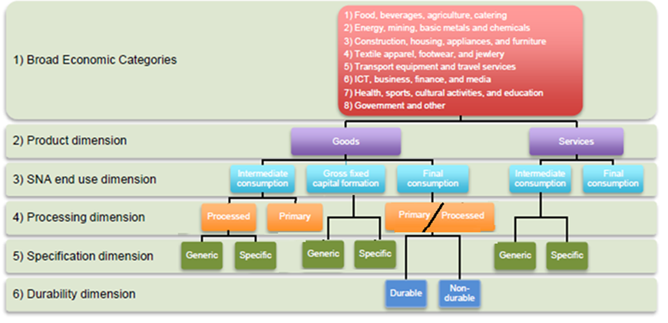
“Streamlined” Structure of BEC Rev. 5

Slide 16
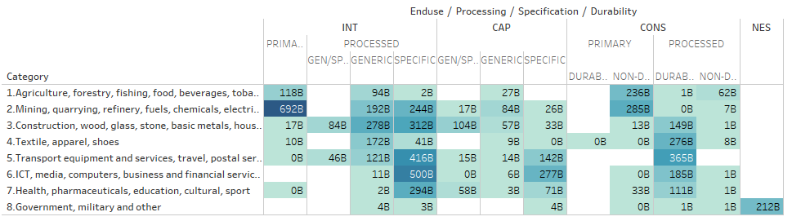
Implementation examples:
Correspondence between BEC 5 and HS for goods and CPC for services:
https://unstats.un.org/unsd/classifications/Econ
Imports of USA, UK, China, Germany and France in BEC 5 – Broad Economic Categories, recent years

